Slide 1
Speeding-up KNN with Dataspace Latticing and Precomputation using Distance Weighting
Alan Zhu and Leonardo Valli

Slide 2
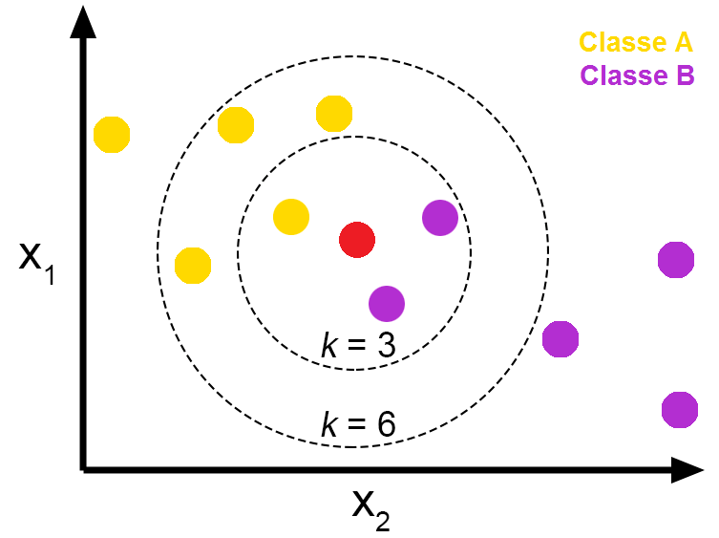
Introduction
KNN is a simple algorithm good at classifying clusters
However, it has O(N) classification runtime
Previous implementations have sped it up to O(log N)
We want to speed it up to O(1) using a lattice
Notes:
leo

Slide 3
Related Work
Proximity Search / Approximate Nearest Neighbors (ANN)
Annoy by Spotify
Faiss by Meta
O(log N) classification
Product-Quantization KNN (PQKNN)
k-Means centroiding
O(N) but can be sublinear dependent on hyperparameters
Distance-weighted KNN
Notes:
alan

Slide 4

Dataset
Transiting Exoplanet Survey Satellite (TESS) Dataset
61 attributes - identification, position, planet properties, stellar properties, dates.
Class - TESS Follow-Up Working Group Disposition (TFOPWG): Confirmed or rejected
https://exofop.ipac.caltech.edu/tess/
Notes:
leo

Slide 5
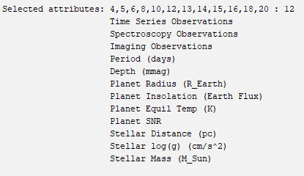
Preprocessing
Made class binary
Intuitively removed attribute
Removed 1 mostly empty attribute
Z-score normalized due to outliers
CFS subset attribute selection
Notes:
leo

Slide 6
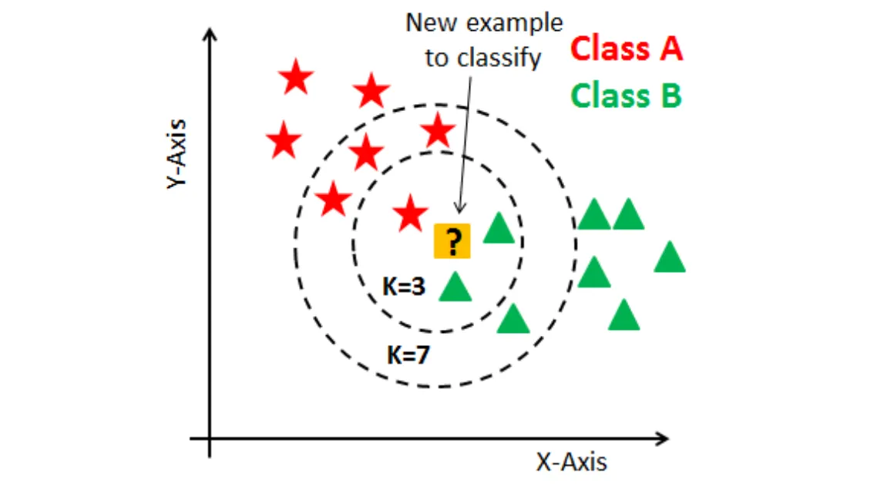
KNN

Slide 7
Goal: Achieve O(1) classification with KNN without sacrificing accuracy

Slide 8
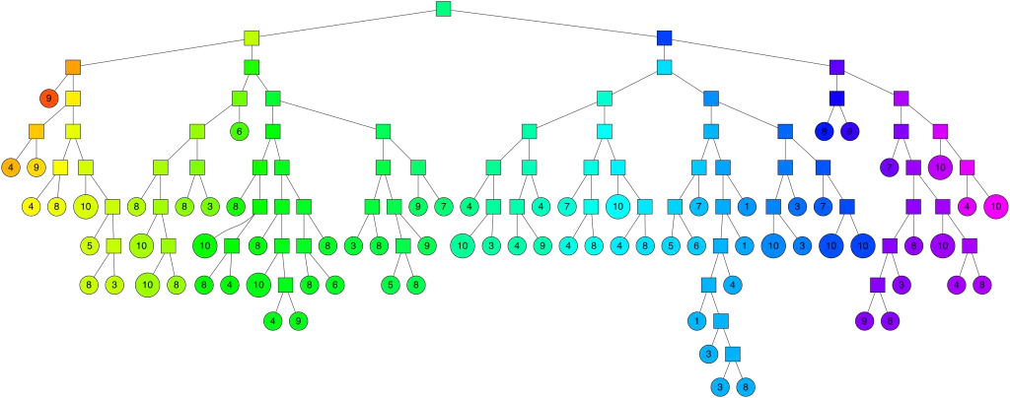
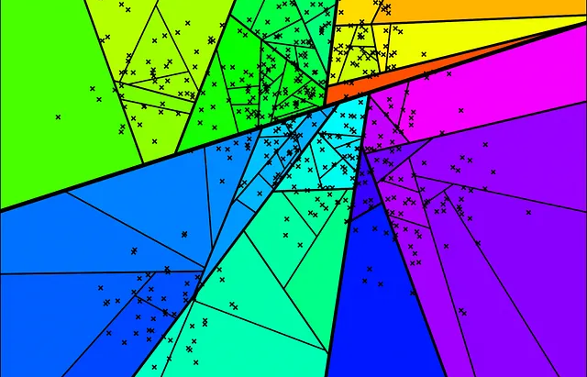
Proximity Search
O(log N)

Slide 9
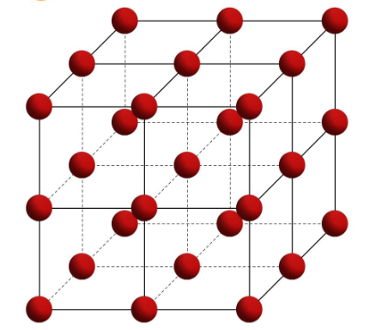
Dataspace Latticing
O(1)

Slide 10

Gaussian Distribution

Slide 11
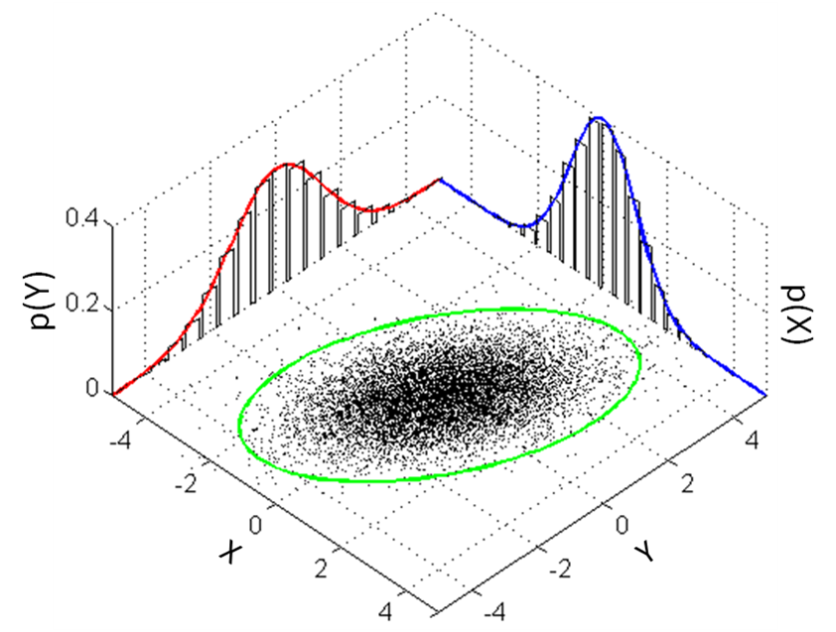
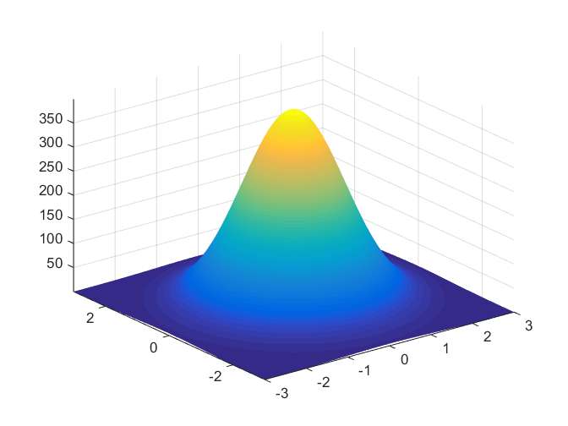
Multivariate Gaussian Distribution

Slide 12
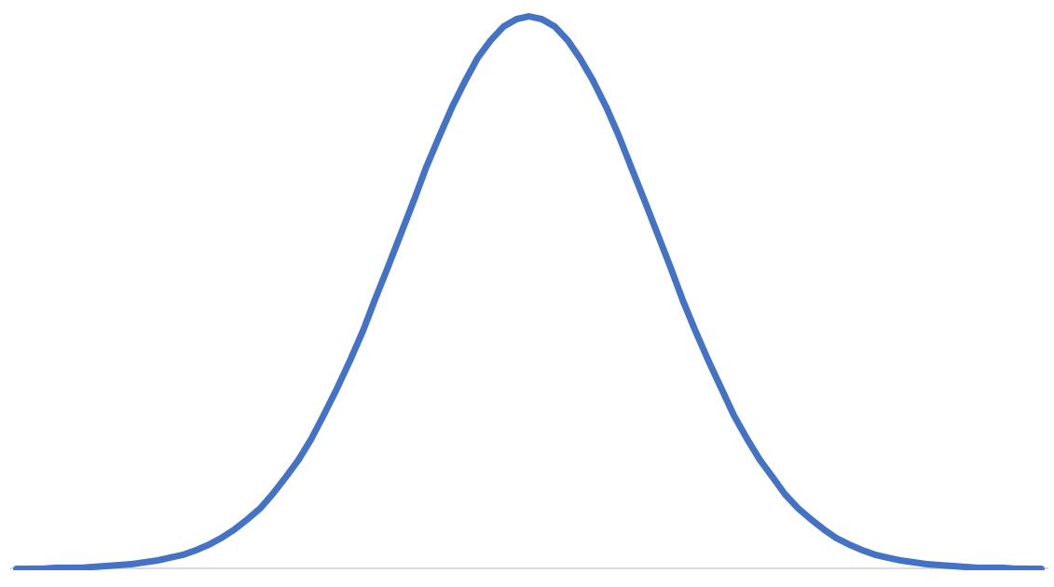
Optimize Lattice Points - Evenly Divide Dataspace

Slide 13
Optimize Lattice Points - Evenly Divide Dataspace

Slide 14
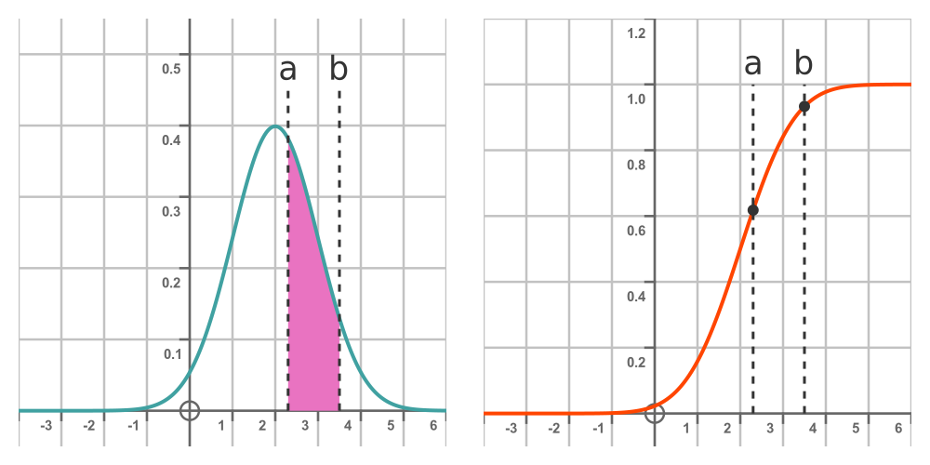
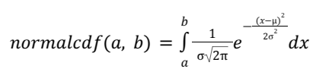
NormalCDF

Slide 15
NormalCDF
x₁
x₂
x₃

Slide 16
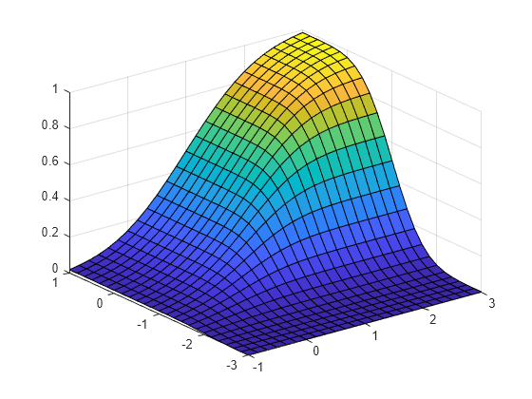
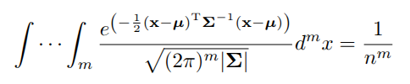
Multivariate NormalCDF

Slide 17
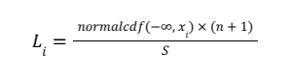
Lattice Build and Classification
Generate the lattice points
Compute the KNN classification at each point using proximity search
Store the classifications in a lattice (dictionary)
Can be saved/loaded
Classify instances by looking up the classification in the lattice
0.1, 0.2, 0.3

Slide 18
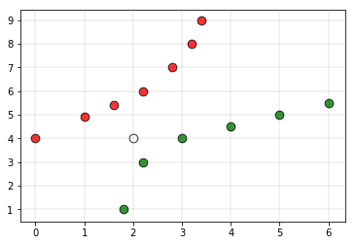
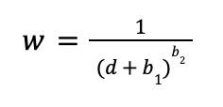
Distance Weighting
The problem with a simple majority-voting approach
K = 5…
Notes:
leo

Slide 19
Distance Weighting
Distance-weighting didn’t change much
Could be because k=3
Could be because there wasn’t much performance loss in the first place
Notes:
leo

Slide 20
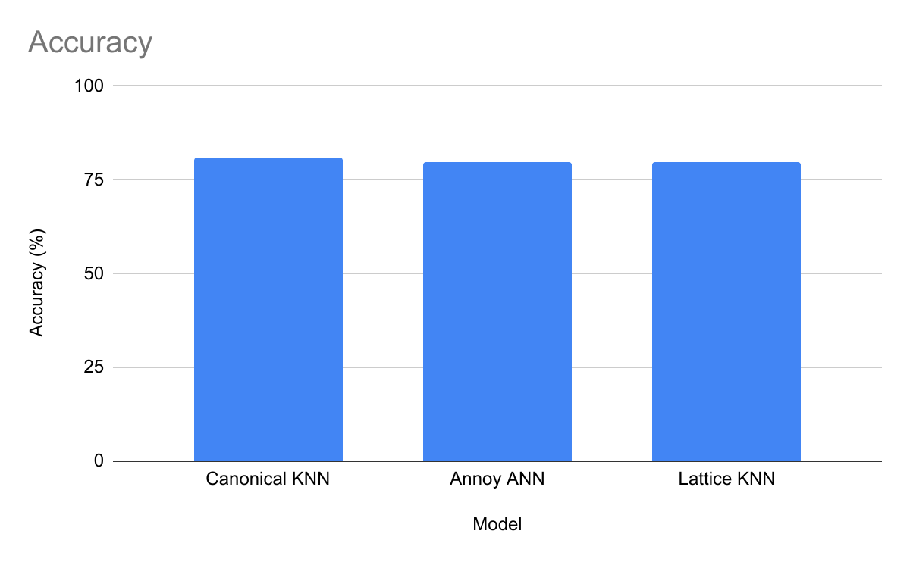
Results - Accuracies
Model | Accuracy
Base KNN | 80.8%
Proximity Search KNN | 79.9%
3-slice Latticing Precomputation KNN | 77.7%
4-slice Latticing Precomputation KNN | 79.6%
Notes:
leo

Slide 21
Results - Confusion Matrices
Model | Confusion Matrix
Base KNN | 0 1 0 254 77 1 59 260
Proximity Search KNN | 0 1 0 268 75 1 58 249
3-slice Latticing Precomputation KNN | 0 1 0 253 90 1 44 263
Notes:
leo

Slide 22
Now for the runtimes!
Drumroll please….

Slide 23
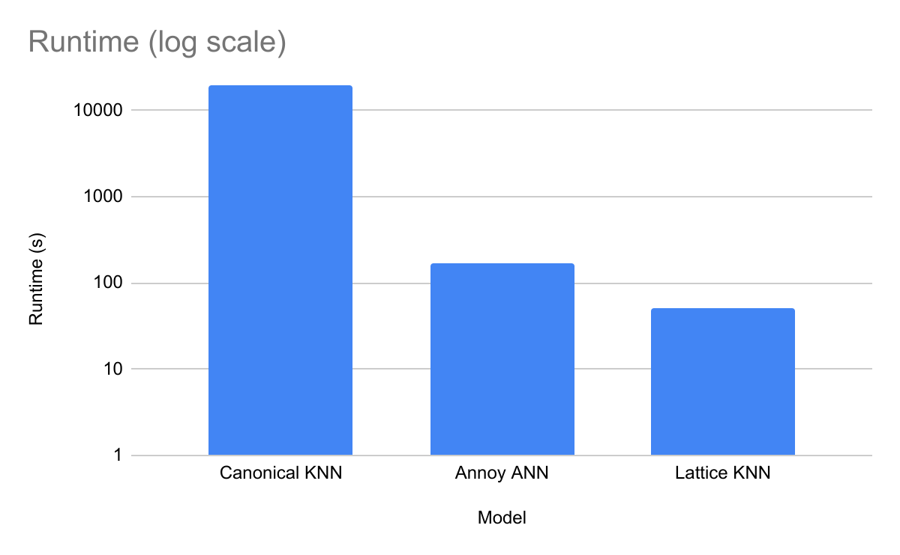
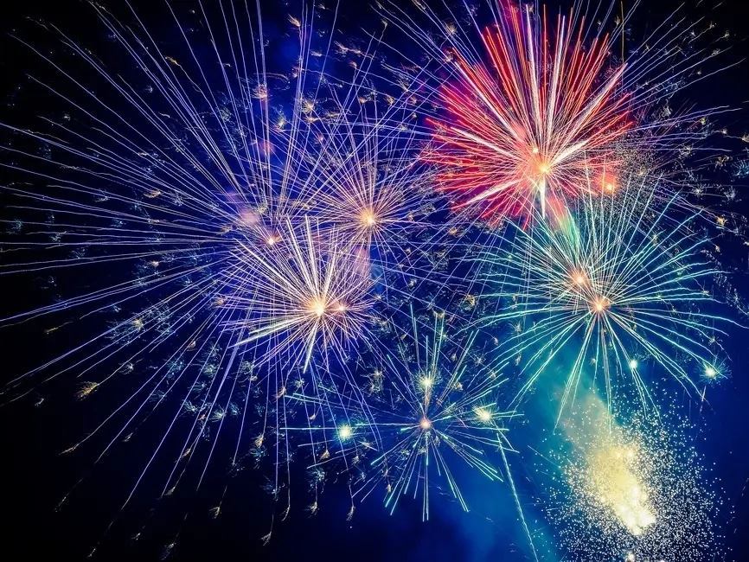
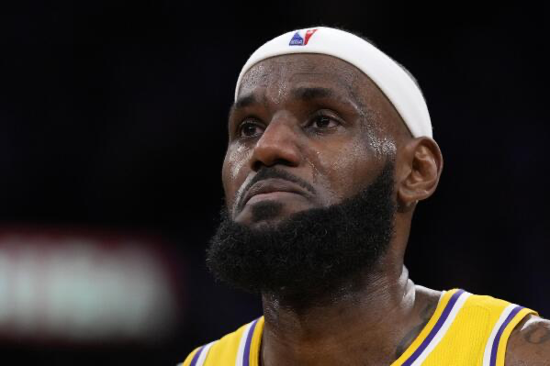
Results - Classification Runtimes (10000 runs)
Model | Runtime (s)
Base KNN | 19500
Proximity Search KNN | 171
Latticing Precomputation KNN | 51
Notes:
leo

Slide 24

Conclusions
Model building takes time
Classification is sped up immensely
Computation time is no longer dependent on number of instances: O(1)
Minimal accuracy loss
Notes:
alan

